Slide 1
Online Counseling
Getting Started & Best Practices
Academic Senate
Counselor Institute 2009
Presenters:
Belen Torres-Gil Rio Hondo College
Stephanie Dumont Golden West College

Slide 2
Today’s Topics:
Online Counseling as a Delivery system
Intake Management Systems
Effective Practices
Online Counseling Program Examples
What Research is Telling Us About Students Perceptions & Experiences
Into the Future
Region 8 Online Counseling Consortium

Slide 3
Online Counseling
As a Delivery System
The paradigm shift
  Effective counseling services can take place outside of an office
Defining terms
  Are we counseling or advising?*
  *See “Role of Counseling Faculty in the California Community College” a document of the CCC Academic Senate
Notes:
Counselors interested in Online Counseling as a delivery system need to know that there are many questions they need to ask themselves before getting started. Fortunately, many other colleges have already “walked the path” and can be of great assistance to any college needing help getting started.

Slide 4
Counseling Advising
Academic, career, personal counseling
Diagnosing/prescribing
Clarifying choices, actions and goals
Assisting with decisions planning and transitions
Providing support and instruction
Understanding human/ student development and counseling theories
Providing specifically requested information for reaching stated goal
Explaining and clarifying information
Supporting activities
  Outreach
  Registration
  Use of resources
  Scheduling students in classes recommended by a counselor
Notes:
Common question often arises about online counseling services. 1) What online counseling services should be offered? 2) Who should provide the service? and 3) Is online counseling really counseling or is it advising. These are questions that each campus offering online counseling program must address. Online Counseling services offered by campuses vary. The most comprehensive often complement extensive distance education programs and may offer discussion of grades and test scores, completion of ed plans. and transcript evaluation. Some campuses prefer to reply to questions in a more general way, without specially referring to transcript information. When more extensive assistance is needed, students are referred to in-person counseling on campus. Often this practice is in place due to concerns over confidentiality. Still other campuses divert intakes to appropriate classified staff or are contemplating using paraprofessional advisors to answer requests for specific information. The Academic Senate’s paper on the Role of Counseling Faculty in the California Community Colleges discusses the role of counselor and distinguishes it from that of the advisor. In summary, counseling goes beyond advising. Advising is embedded in counseling. Counseling is comprehensive, diagnostic and considers a breadth of interrelated and complex issues, alternatives, and implications as students are assisted in decision making.

Slide 5
Sample Online Questions
“This is my first time attending Cerritos Summer courses, I am planning to take two classes in one session, Sociology and Philosophy, is this too much to take. Or should i just take one course to be on the safe side?”
“I have many withdrawals and I was wondering if I would still be able to transfer to a UC?”
“This is my second semester here at Cerritos. I am still unsure about what my major might be. I was thinking maybe political science, but I’m not very sure yet. I had someone tell me that I should get involved with the student government here. They said it would be a good thing to get involved, since I'm looking at political science as my major. My question is, how or where do I go to get involved? I am still new to the college and don't really know where to go for everything yet, or even who to ask. Thank you for your help.”
Notes:
These are samples of questions submitted by students. Online Counseling inquiries reflect the same issues/concerns as those of on-campus students. Online counseling traffic mirrors what is going on in the office. We receive more inquiries as registration approaches and then once classes begin, the number of intakes slows in the first few weeks of the semester.

Slide 6
More Questions
“Hi my name is Matt, and I have one question. I want to take Architecture 111 this summer, but Cerritos College doesn't offer it. So I am wondering, if I want to take it at another college, such as Rio Hondo College, how will I know that I will get the equivalent course. As you know, different schools have different course titles. Can you help me?”
“This is in regard to my tuition fees. I have tried to get this rectified but to no avail. Please help me or please point me in the right direction. I was told before I re-registered for class that even though I am currently in Japan (due to military obligations) I would not be considered a non-resident. I actually live in Pico Rivera and will be returning in a few months. I still have the charge of $1,434.50 on my account for a non-resident tuition. Due to the time difference, I’m using online counseling to solve this problem. Can you please provide me with a response? Thank you.”
Notes:
Online Counseling provides access to a broader range of students including students taking online courses, disabled, military, incarcerated, busy moms, and working professionals who would normally find it difficult to visit a campus. Online counseling also provides a way for international and out-of-state students to easily seek assistance. In addition, students who are shy, easily intimidated, or seek the anonymity of online services can have direct contact with counselors.

Slide 7
Online Counseling
As a Delivery System
Considerations when starting an online program
  Soliciting buy-in and support
    Successful online counseling systems have strong partnerships with tech support, counselors and buy-in from administration
  Deciding what types of services to provide online
  Selecting an intake management system

Slide 8
E-mail Based
Intake Management System
Features
  Can systematize random email inquiries received by counselors
  Limited security
  Requires central counselor to review/refer intakes to other online counselors
  Limited ability to manage/organize intakes
Notes:
Most campuses will start with a simple email based system just as a way to organize and filter the questions that they are currently receiving. The key component to starting with an email based system is to have a willing counselor who will receive, review and filter intakes and an Intake form located in a spot (on the college website) that students would naturally go to to seek counselor assistance.

Slide 9
E-mail based
Online Inquiry Flowchart
STUDENT
College Website
Online Counseling Intake Form
Central Counselor
Counselors
Counselors
Counselors
Counselors
Counselors
Counselors
Counselors

Slide 10
Web-based
Intake Management System
Features
  More secure
    Password protected, encrypted
  Stores questions & replies
  Searchable database
  Follow-up questions sent directly to counselor
  Built-in referral system linked to email
  Comments for counselor-only viewing
Notes:
A web-based intake management offers much great flexibility in reviewing, locating, and tracking student questions.

Slide 11
More Web-based Features
  Counselor enters days available and vacation dates
  Counselor can return a question for reassigning
  Multiple coordinators can screen & assign
  Students can submit quick or detailed questions
  Menu of web referrals built-in
  Spell check
Notes:
Systems should be counselor-friendly with features that allow them to search the database, select they days they are available to provide online counseling, and return questions when they know they will not be able to reply in a timely way or they think another counselor could better assist the student. At Cerritos, we’ve surveyed the online counselors and they have said that they find online counseling “fun, efficient, and effective.”

Slide 12
Online Counseling
Effective Practices
Online Counseling Programs Examples

Slide 13
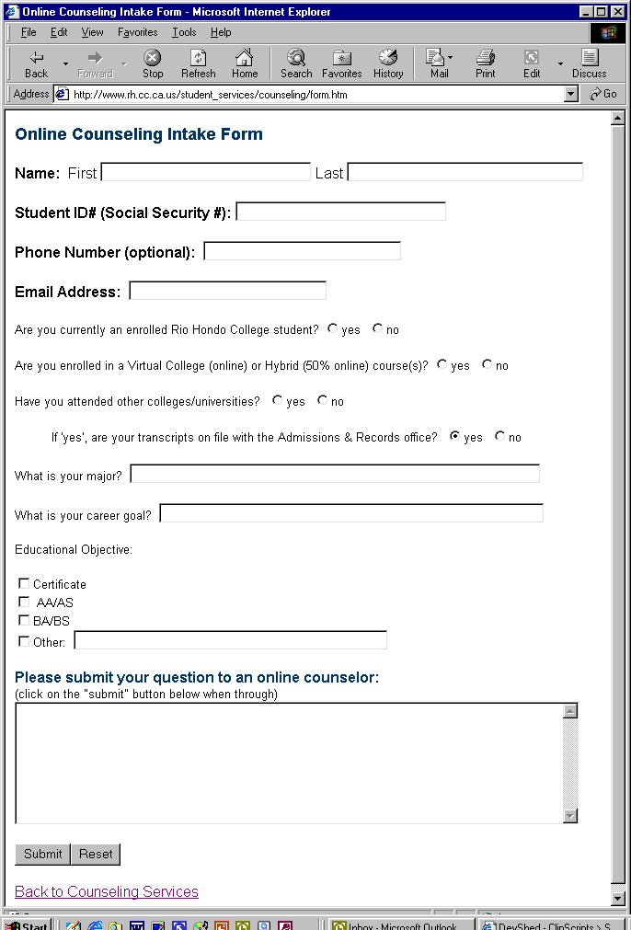
Online Counseling
Effective Practice – The Intake

Slide 14
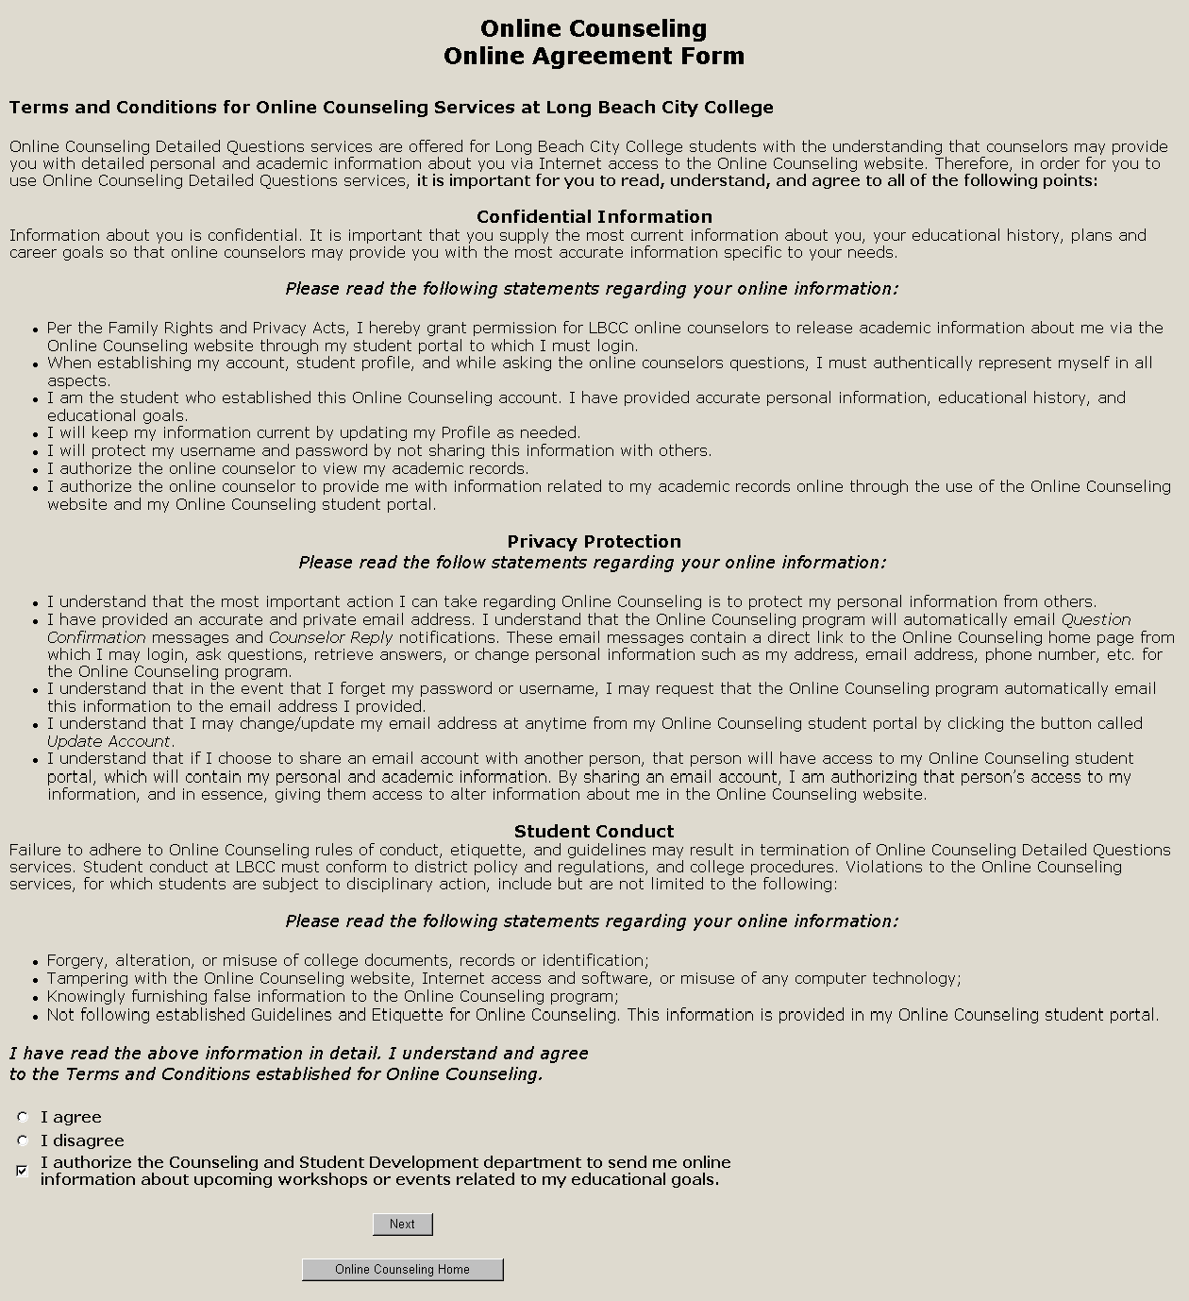
Online Counseling
Effective Practice – Online Agreement
Notes:
Long Beach City College provides an example of a disclaimer agreement.

Slide 15
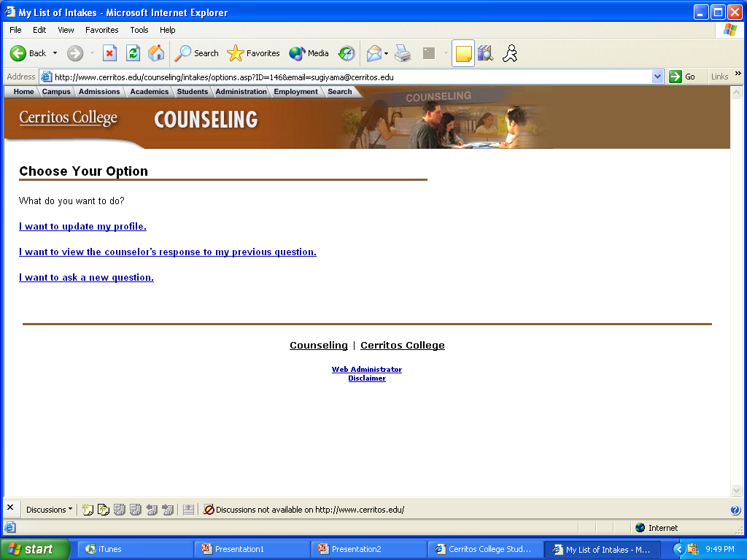
Online Counseling Program
Cerritos College

Slide 16
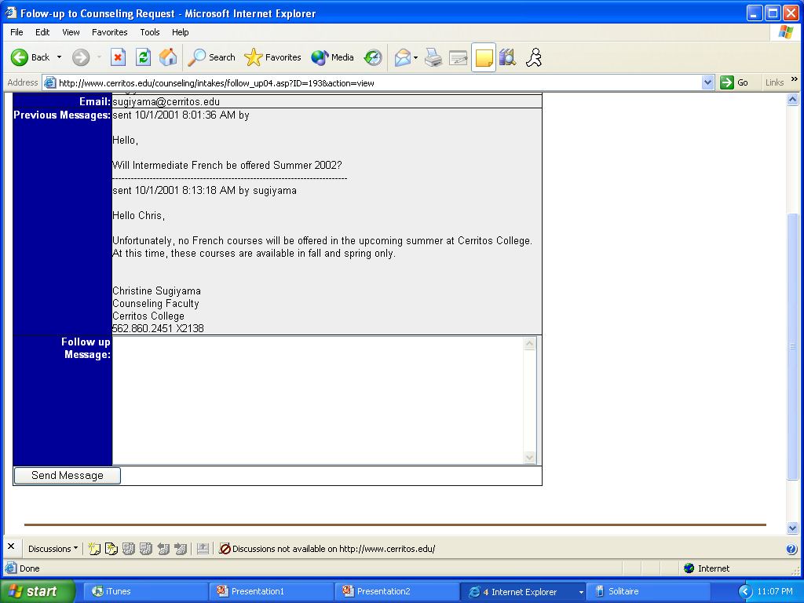
Online Counseling
Cerritos College
Notes:
This screen shot displays a student’s question, the counselor’s reply, and the pane where the counselor can enter a follow-up message.

Slide 17
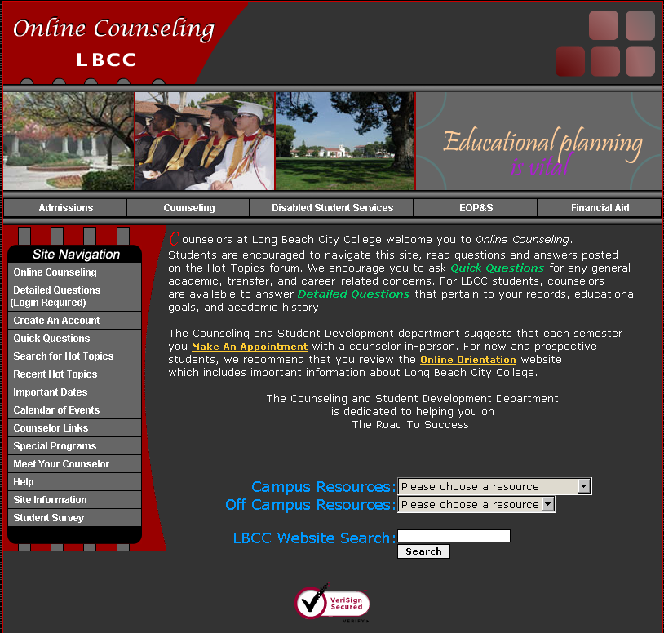
Online Counseling
Long Beach City College

Slide 18
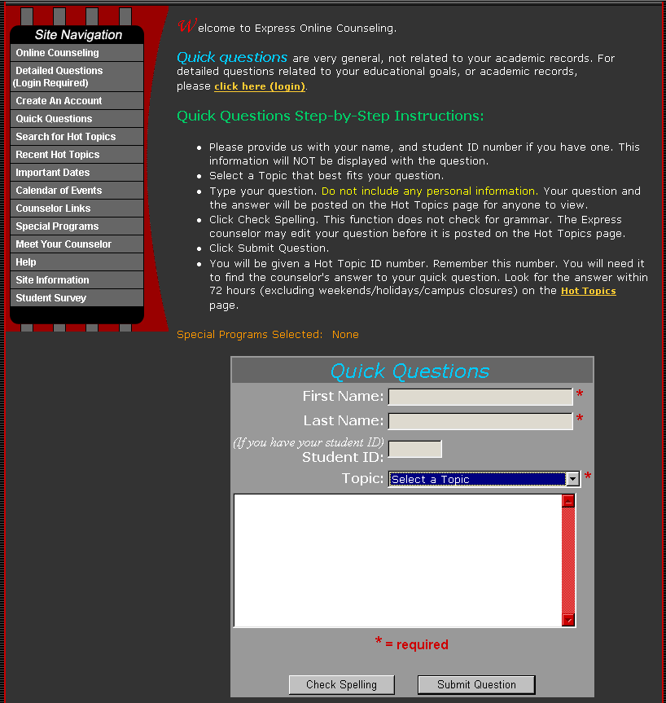
Online Counseling
Long Beach City College
Notes:
At LBCC, students can submit either a general “Quick Question” or a “Detailed Question” related to their educational goal or academic record.

Slide 19
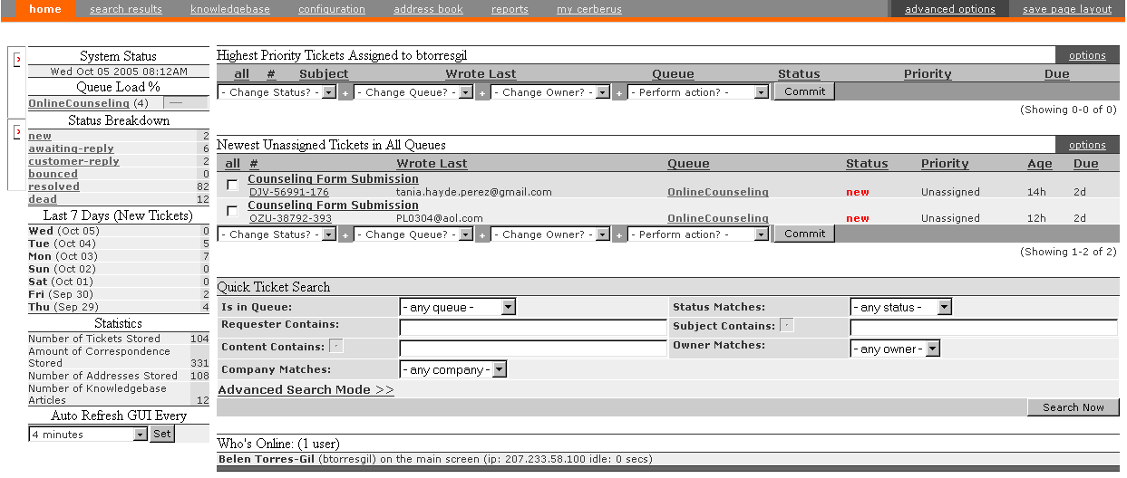
Online Counseling
Rio Hondo College

Slide 20
Local Research Study: “Understanding the Perceptions & Experiences of Students & Counselors Engaging in Online Community College Counseling”
Qualitative Results:
  Flexibility and Convenience
  Connection to Counselors
Quantitative Results:
  Student Focus Groups
Notes:
Qualitative results supported by quantitative results.

Slide 21
Online Counseling
Ongoing issues
  Workload/balance
  Confidentiality and security
  Access and accessibility
  Student learning outcomes
  System maintenance & upgrades
  Training, evaluation and follow-up
Notes:
Integration and coexistence with student data management systems that many colleges are adopting.

Slide 22
Online Counseling
Into the Future
Online Counseling is here to stay and campuses continue to find newer and better ways to manage intakes and to provide additional services online
Technology has advanced to facilitate real time and teleconferencing counseling
Online Counseling can play a greater role in enrollment management and retention of students
Online Counseling can play a greater role in supporting online instructional faculty, programs and students
Regional & statewide discussions continue to define terms and best practices as this delivery system evolves
  Spring 2008 ASCCC Resolution
Notes:
Springl 08 ASCCC Resolution:
8.01 Support for Online Counseling Services
Whereas, The Academic Senate for California Community Colleges is the organization whose primary function is to make recommendations with respect to academic and professional matters as defined in Title 5 §53200;
Whereas, Standards or policies regarding student preparation and success are among the policy development and implementation matters embedded in academic and professional matters;
Whereas, Counseling faculty play an integral part in facilitating student preparation and success by providing appropriate and necessary programs and services, and one of the critical responsibilities of the counselor is to support student success in the areas of self-assessment, decision-making, and goal implementation; and
Whereas, Any California community college which has an online instructional program is mandated by the accreditation standards to provide appropriate services to students engaged in online services, including counseling and coursework; Resolved, That the Academic Senate for California Community Colleges inform local senates of the accreditation standards that relate to student services for distance education programs in order to facilitate the development and implementation of viable online counseling programs and services designed, led, and facilitated by counseling faculty;
Resolved, That the Academic Senate for California Community Colleges provide professional development activities related to online counseling services and develop written documents describing effective practices for the provision of online student services in the California community colleges; and
Resolved, That the Academic Senate for California Community Colleges support establishing a lower student-to-counselor online ratio, as with many online course student-to-instructor ratios, in order to facilitate effective and adequate development and delivery of a labor intensive counseling model.
MSC Disposition: Local SenatesAssigned to: Counseling and Library Faculty Issues

Slide 23
Region 8
Online Counseling Consortium
Cerritos College ~ Citrus College ~ Coastline College ~ Cypress College ~ Fullerton College ~ Golden West College ~ Irvine Valley College ~ Long Beach City College ~ Mt. San Antonio College ~ Orange Coast College ~ Rio Hondo College ~ Saddleback College ~ Santa Ana College ~ Santiago Canyon College
Notes:
A number of Region 8 colleges have been engaged in Online Counseling/Advising activities since 1998. In February 2005, Cerritos College and Long Beach City College co-hosted what was to become the first Online Counseling Consortium in the state. Twenty-seven counselors, deans, and web administrators representing thirteen of the fourteen Region 8 community colleges attended this first meeting. Most of the community colleges in Region 8 have active online counseling programs. Those few who don’t, are in the beginning stages of initiating programs.

Slide 24
Region 8 Online Counseling Consortium Founded February 2005
MISSION:
Share and establish best practices in online counseling
Discuss common protocols, definitions, issues, concerns
Provide professional development activities for consortium members
Provide expertise to other colleges seeking to establish
online counseling programs
Serve as resource to state advisory committees regarding online counseling issues and trends
Notes:
Since the first Region 8 Online Counseling Consortium meeting, it has become clear that we are pioneers in establishing a new delivery system of service to students. Our mission is multifaceted and sometimes the issues complex. Nonetheless, online counseling has proven to be a necessary and valued means of assisting students. Consortium members, committed professionals, collaborate regularly to identify issues and recommend ways to facilitate the process.

Slide 25
Region 8 Online Counseling Consortium
First online counseling regional consortium meeting 2005
Hosted online counseling showcase
Established taskforces to address issues
Established leadership structure
Meet every semester
March 2008 – Hosted ReadyMinds Distance Counselor Training
Notes:
One of the first region activities of the consortium was to host an Online Counseling Showcase at Fullerton College that highlighted the many ways that region colleges were conducting online counseling services. This Showcase helped to establish a “baseline” for those colleges seeking to establish this type of service at their colleges and gave more active programs ideas for ways to improve their systems. It also helped region members to identify the common elements that every successful program should contain and the common questions that every college should ask before starting a program of their own.
Our mission is multifaceted and sometimes the issues are complex because they intertwine with so many other issues.
Taskforces
Legal and Contractual Issues (combined with Best Practices/Standards & Guidelines)
Technology Issues (to include software, ADA compliance
Grant funding/Research)
Online Counseling Development Strategies (to include evaluating, exploring, developing systems)
Marketing/advertising/Buy-in strategies
Symposium Coordination
Training and Professional Development (added)*
Members serve on Academic Senate Sub-Committee updating the Role of Counseling Faculty paper
Presented at League for Innovation, FACCC and Academic Senate Spring Plenary Session
At this time we have assisted 8 community colleges in starting online counseling programs (as of March 07)
Plan to host a regional symposium for online counselors
Presented at 06 Online Teaching Conference

Slide 26
Region 8 Online Counseling
Consortium Contacts
Belen Torres-Gil
1st Co-Chair
Rio Hondo College
btorresgil@riohondo.edu
Kenna Hillman
2nd Co-Chair
Long Beach City College
khillman@lbcc.edu

Slide 27
Special Thanks
To Kenna Hillman for use of the Long Beach City College online counseling slides
To Chris Sugiyama for use of Cerritos College online counseling slides
To Belen Torres-Gil for use of Rio Hondo College online counseling slides
To Chris Garcia for sharing his thesis research
Academic Senate: The Role of Counseling Faculty in the California Community College: http://www.academicsenate.cc.ca.us/Publications/ Papers/Role_counselingfaculty.html

